Slide 1



Bank fraud
Detection model

Slide 2
By the team:
Mandar Kelkar
Gagan Rao
Krishna
Sara
Aashika Shravani
Umesh Anand

Slide 3
Methodology of the project
Data Exploration and Visualization: Perform exploratory data analysis to gain insights into the dataset
Data Preprocessing: Preprocess the data by handling missing values, converting categorical features into numerical representations, and performing feature scaling if necessary.
Model Training: Train different classifiers such as K-Nearest Neighbors (KNN), Random Forest, and XGBoost on the preprocessed data.
Model Evaluation: Evaluate the trained 5. Ensemble Model: Create an ensemble model using Voting Classifier to combine the predictions of multiple classifiers and improve overall performance.
Conclusion: Summarize the results, discuss the performance of the models, and provide insights for future improvements.

Slide 4
Bank Fraud Detection Techniques
Bank fraud detection is a crucial aspect of maintaining the security and integrity of the banking system. It involves using various techniques and technologies to identify and prevent fraudulent activities, protecting both the financial institution and its customers.
Transaction Monitoring: Banks continuously monitor customer transactions for any unusual or suspicious activities.
Anomaly Detection: Machine learning algorithms are utilized to build models based on historical transaction data. When a transaction falls outside this norm, it raises a red flag for further investigation.
Geolocation and IP Tracking: Banks use geolocation and IP tracking to verify the physical location of customers during transactions.
Device Identification: Banks can recognize and track the devices (e.g., computers, smartphones) used by their customers for banking activities.

Slide 5
Our project overcome by
The project demonstrates the application of machine learning techniques to detect bank fraud using a synthetic dataset. The ensemble model, combining multiple classifiers, shows promising results in accurately identifying fraudulent transactions. However, further optimization and fine-tuning of the models can be explored to improve performance.

Slide 6
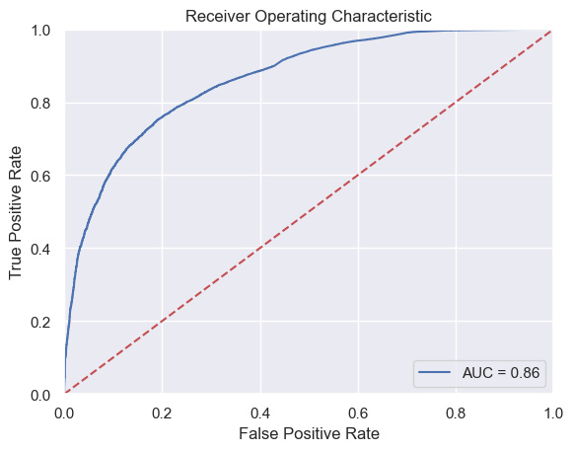
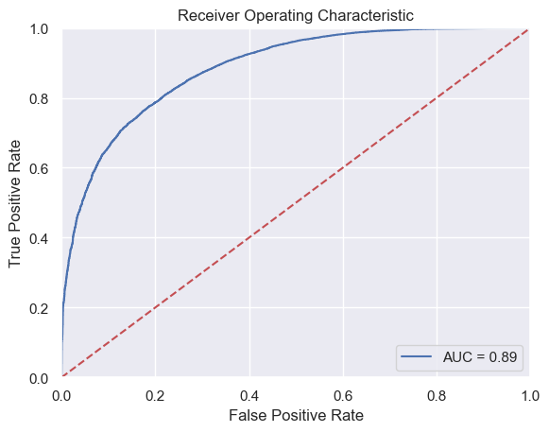
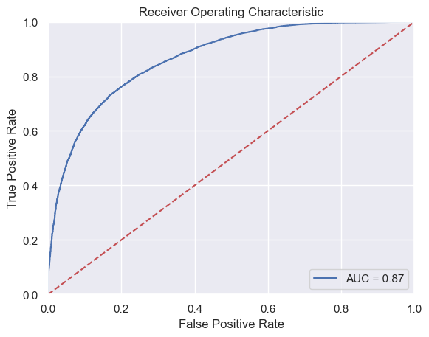
Snap Shots

Slide 7
result
The project utilizes K-Nearest Neighbors, Random Forest, XGBoost, and an ensemble model for bank fraud detection. Here are the key results:
- K-Nearest Neighbors achieved an accuracy of 89% with precision, recall, and F1-score of 0.91, 0.97, and 0.94, respectively.
- Random Forest Classifier achieved an accuracy of 78% with precision, recall, and F1-score of 0.96, 0.78, and 0.86, respectively.
- XGBoost Classifier encountered an error during training, so the results are not available.
- The ensemble model combining KNN, Random Forest, and XGBoost achieved an accuracy of 89% with precision, recall, and F1-score of 0.91, 0.97, and 0.94, respectively.

Slide 8
Result
Classification Report for Ensemble Models:
precision recall f1-score support
0 0.44 0.63 0.52 7121
1 0.94 0.89 0.91 49880
accuracy 0.85 57001
macro avg 0.69 0.76 0.72 57001
weighted avg 0.88 0.85 0.86 57001
Confusion Matrix of Ensemble Models:
[[ 4494 2627] [ 5721 44159]]
Classification Report for XGBoost: precision recall f1-score support 0 0.82 0.35 0.49 7121 1 0.91 0.99 0.95 49880
accuracy 0.91 57001
macro avg 0.87 0.67 0.72 57001
weighted avg 0.90 0.91 0.89 57001
Confusion Matrix of XGBoost:[[ 2516 4605] [ 559 49321]]

Slide 9
Result
Classification Report for Random Forest Classifier: precision recall f1-score support
0 0.33 0.78 0.47 7121
1 0.96 0.78 0.86 49880
accuracy 0.78 57001
macro avg 0.65 0.78 0.66 57001
weighted avg 0.88 0.78 0.81 57001
Confusion Matrix of Random Forest Classifier:
[[ 5530 1591] [11009 38871]]
Classification Report for Random Forest Classifier: precision recall f1-score support
0 0.33 0.78 0.47 7121
1 0.96 0.78 0.86 49880 accuracy 0.78 57001 macro avg 0.65 0.78 0.66 57001
weighted avg 0.88 0.78 0.81 57001
Confusion Matrix of Random Forest Classifier:[[ 5530 1591] [11009 38871]]

Slide 10
Result
Classification Report for K-Nearest Neighbors:
precision recall f1-score support
0 0.60 0.33 0.42 7121
1 0.91 0.97 0.94 49880
accuracy 0.89 57001
macro avg 0.76 0.65 0.68 57001
weighted avg 0.87 0.89 0.87 57001
Confusion Matrix of K-Nearest Neighbors:
[[ 2332 4789] [ 1534 48346]]

Slide 11
Reference link
StackOverflow-https://stackoverflow.com/
ChatGPT-https://chat.openai.com/
YouTube-https://www.youtube.com/

Slide 12
Thank you

